Slide 1


Automated Question Bank Generation System
PBL Review – 3 · Computer Science & Engineering · KL Deemed to be University
Team
System Overview
Deekshith Reddy P – 2510030389
Jashwanth Yadav G – 2510030155
An intelligent system that automatically generates, categorizes, evaluates, stores, and retrieves questions from textbooks and PDF educational content.

Slide 2
Problem Statement
Manual question preparation remains a persistent challenge for educators across academic institutions.
⏱ Time-Consuming
🔁 Repetition
Manual question preparation is slow, repetitive, and resource-intensive for faculty
Common questions reappear across question banks, reducing assessment diversity and quality
📂 Poor Management
⚖ Inconsistency
Maintaining large question banks is difficult, inefficient, and prone to disorganization
Difficulty levels and topic organization are often inconsistent across manually curated banks

Slide 3
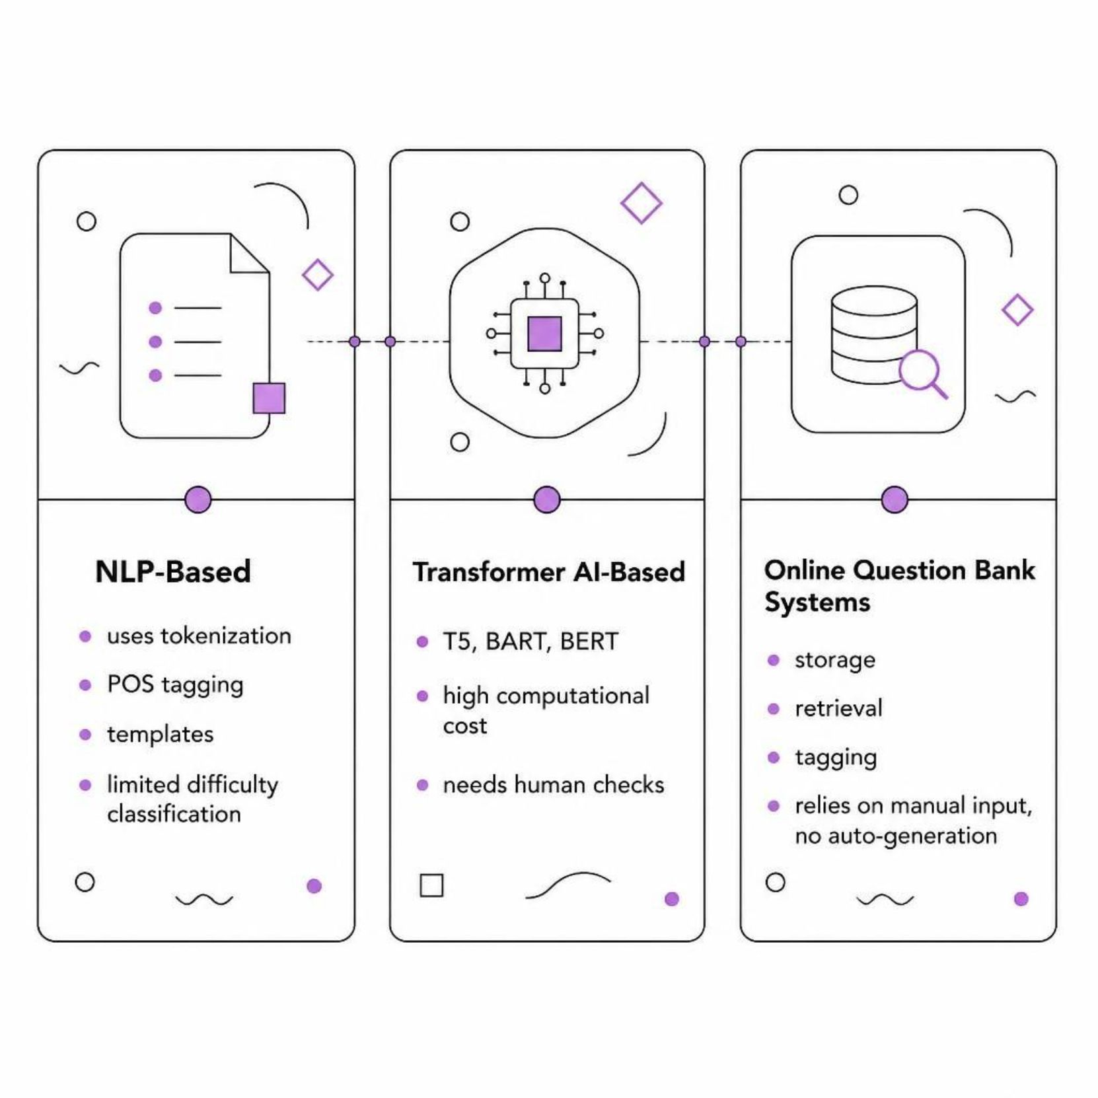

Literature Review & Research Gap
Research Gaps Identified
Limited automatic topic-wise organization of generated questions
Weak difficulty estimation and quality scoring pipelines
Duplicate and low-quality questions remain unfiltered
Advanced AI methods demand high computational resources
Insufficient search, filtering, and export capabilities
No existing system integrates generation, classification, difficulty, quality control, and export in a single pipeline.

Slide 4

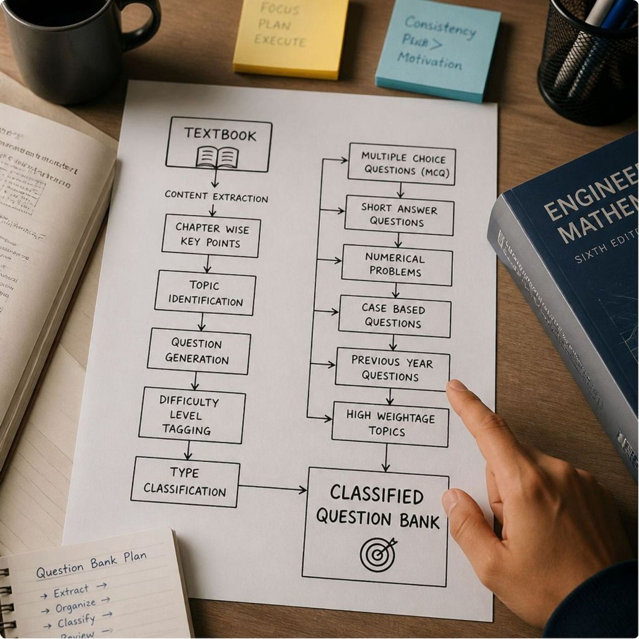

Proposed Methodology
Complete System Pipeline — from raw educational document to organized, searchable question bank
Upload
Process OCR
Extract Keywords
Classify Topics
Technologies: Python · spaCy · NLTK · SQLite · Optional Flask/Django UI · REST API

Slide 5

Adaptability of Methodology
The system is modular and can be adapted to different educational contexts, subjects, and platforms.
Input Adaptability
Subject Adaptability
Printed or digital textbooks
Digital PDFs
Scanned PDFs via OCR
Computer Science & Engineering
Mathematics & Sciences
Engineering disciplines
Other academic subjects
Question Adaptability
Platform Adaptability
MCQ, Short Answer, Numerical
Case-based questions
Easy / Medium / Hard levels
SQLite database (current)
CSV / JSON export
Flask/Django UI [Future]
REST API & LMS [Future]
Modularity Advantage: Individual components can be improved or replaced without changing the complete system.

Slide 6
Novelty of Developed Methodology
"A unified question-bank pipeline combining generation, topic classification, difficulty estimation, quality checking, storage, and export — all in one integrated system."
Key Novelties
Comparison: Existing vs. Our System
Automatic PDF/Textbook Ingestion
Feature | Existing Systems | Our System
Generation & Storage | Separate tools | Integrated
Topic Classification | Manual tagging | Automatic
Difficulty Estimation | Not available | Heuristic + ML
Duplicate Filtering | Manual review | Automated
Multi-format Export | Limited | CSV / JSON
Accepts educational documents directly without manual data entry
Hybrid Question Generation
Combines template-based + Transformer-based approaches for quality and efficiency
Automatic Topic Organization
Classifies questions by topic without manual tagging
Quality & Duplicate Filtering
Removes low-quality and duplicate questions automatically

Slide 7
Methodology Evaluation
Proposed evaluation framework to assess question quality and system performance. Actual experimental results will be documented during implementation testing.
Evaluation Criteria
Expected Outcomes
Evaluation Area | Expected Result
Question Quality | Relevant & understandable
Topic Classification | Correct topic assignment
Difficulty Level | Appropriate classification
Duplicate Detection | Reduced duplicates
Search & Retrieval | Fast and efficient filtering
Human Validation | Teacher-confirmed quality
Question Quality
Correctness
Meaningful, grammatically correct, and understandable
Accurately matches source educational content
Topic Classification
Duplicate Detection
Assigned to the correct topic automatically
Similar and repeated questions effectively removed
Retrieval Performance
Teachers can search and filter questions quickly

Slide 8


Dissemination & Accessibility
Workflow: Generate → Store → Search → Filter → Export → Use in Tests/Practice
Storage & Search
Access Interfaces
SQLite Database: Questions stored with rich metadata — topic, difficulty, type, source
Indexed for Performance: Fast retrieval and filtering
Filter by Topic, Difficulty Level, Question Type, or Keywords
SQLite
Direct developer access (current)
Web UI
Export Formats
Flask/Django interface [Future Scope]
CSV: Spreadsheet apps and test creation tools
JSON: Programmatic access and integration
REST API
Programmatic integration [Future Scope]
LMS
Learning system integration [Future Scope]
End Users
Teachers & Educators · Students (for practice) · Academic Institutions

Slide 9

Conclusion & Future Scope
"An automated system that converts textbooks and PDFs into organized question banks by generating questions, classifying them by topic, estimating difficulty, and storing them for easy search and export."
Future Scope
Reduces manual effort in question preparation from textbooks and PDFs
Automatically generates diverse questions with varied difficulty levels
Organizes questions by topic without manual tagging
Structured question-bank storage with rich metadata
Efficient search, filtering, and multi-format export
Improves teacher efficiency and assessment consistency
Advanced Transformer-based generation with quality-ranking models
Multi-language support and improved OCR accuracy
Automated difficulty and quality prediction using ML models
Cloud-based storage and collaborative authoring tools
REST API integration with LMS platforms
Enhanced UI with Flask/Django web interface
Key Contributions
Thank You — Questions & Discussion
Sources: Automated-Question-Bank-Generation-System (2).pptx

